Slide 1
Explainer: VAT v transfer duty in property transactions

Slide 2
DISCLAIMER
The training material provided is intended for training purposes only and should not be relied upon as a substitute for professional advice. The information presented is for general informational purposes and is not intended to be a substitute for legal, accounting, or other professional advice. We make every effort to ensure the accuracy and completeness of the information provided, but we do not guarantee that the information is error-free. We reserve the right to amend any errors in calculation or information presented in the training material. The information provided in the training material may not be suitable for all individuals or situations. You should always seek the advice of a professional before making any decisions based on the information provided. By using the training material, you agree to release us from any liability for any damages or losses, whether direct or indirect, that may result from your use of the information provided. We reserve the right to modify or discontinue the training material at any time without notice.

Slide 3

Introduction
In property transactions, there will never be a scenario where both VAT and transfer duty are payable.
It is always one or the other, never both.

Slide 4
Transfer duty
Transfer duty is payable on the acquisition of immovable property.
Therefore, transfer duty is effectively payable in all property transactions, except where specifically exempt.
Example of such an exemption: When VAT is payable.
GOLDEN RULE: Either transfer duty or VAT is payable (if not exempt).
→ Never both!
GOLDEN RULE: Look to the SELLER to determine which is payable in the specific transaction.
*Is the seller a VAT vendor for purposes of this transaction?

Slide 5
Is the seller a VAT vendor for the purposes of the property transaction?
YES
VAT enquiry
VAT Act
NO
Transfer duty enquiry
Transfer Duty Act
Seller is liable to pay VAT
Purchaser is liable to pay transfer duty

Slide 6
Transfer duty rates (effective 1st April 2025)
VALUE OF PROPERTY IN ZAR | RATE
1 – 1 210 000 | 0%
1 210 001 – 1 663 800 | 3% of the value above R1 210 000
1 663 801 – 2 329 300 | R13 614 + 6% of the value above R1 663 800
2 329 301 – 2 994 800 | R53 544 + 8% of the value above R2 329 300
2 994 801 – 13 310 000 | R106 784 + 11% of the value above R2 994 800
13 310 001 and above | R1 241 456 + 13% of the value exceeding R13 310 000

Slide 7

Examples of transfer duty exemptions
Transaction is subject to the payment of VAT.
Property transfer in terms of a divorce order.
Transfers i.r.o. properties with a value or purchase price of less than R1 210 000.00.
Transfer from a deceased estate to a surviving spouse.
Purchase directly from property developer (on-sales NOT exempt from TD liability).

Slide 8
Penalty on late payment of transfer duty
What to consider when completing long-term transfer dates in OTPs:
If any duty in respect of a property transaction remains unpaid after a period of six months from the date of acquisition of the property, SARS must impose a penalty at the rate of 10% per annum on the amount of unpaid duty.
This amount is calculated in respect of each completed month in the period to the date of payment.
Date of acquisition:
Date of sale (successful conclusion of valid sale agreement, regardless of unfulfilled suspensive conditions at the time of sale).
Donation (Note: Donations tax & transfer duty payable)
Exchange.

Slide 9
VAT transactions
VAT is payable when:
The SELLER is a registered VAT vendor (or is obliged to be registered for VAT) i.e. the seller is a VAT vendor;
AND
The transaction occurs in the course and furtherance of the seller's business.
The purchaser’s VAT/tax status is NOT a determining factor in this circumstance.
VAT is payable at the rate of 15%.
In VAT transactions, the liability and onus to make payment to SARS is on the seller.
How does actual payment of the VAT take place in practice?

Slide 10
Practical examples
Example 1
A is a property developer and registered VAT vendor. A sells a sectional title unit in a development to B for consideration of R2 million.
This transaction will attract VAT, as the sale of the property within the development constitutes a transaction in the course and furtherance of A’s VAT vending business.
VAT is payable by the seller.
Example 2
A now sells his private home to B (which does not form part of his VAT business) for consideration of R2 million.
This transaction will NOT be subject to the payment of VAT but will rather attract liability for payment of transfer duty.
It is payable by the purchaser.

Slide 11

The sale agreement and VAT transactions
GENERAL RULE: Any price charged by a VAT vendor in transactions, which form part of its VAT registered enterprise (for a taxable supply), is deemed to be VAT INCLUSIVE.
Purchase price inclusive of VAT, unless stipulated otherwise in the sale agreement.
Therefore, be mindful when dealing with a seller who is an entity.
A natural person can also be registered as a VAT vendor.
Look at sole proprietorships and partnerships conducting VAT-registered enterprises.

Slide 12

Examples
Developer selling in a development.
Property speculator who buys and sells property.
In individual capacity or through a sole proprietorship, company, or close corporation.
Residential or commercial property.
Seller who owns a commercial rental enterprise.
Seller trading in business from the property.
NB: Exempt supply: The sale of a property that has previously been rented out for residential purposes by a VAT vendor.

Slide 13
An agent’s commission in VAT transactions
Where an estate agent’s commission is not payable on the VAT amount calculated on a purchase price stipulated as being VAT exclusive:
Example 1
If the purchase price is R3 million excluding VAT and agent’s commission is 5% plus VAT, then the commission is calculated on R3 million only.
= R150 000 + 15% VAT = R172 500.00
Example 2
If the purchase price is R3 million inclusive of VAT, then 5% agent’s commission is calculated on the amount of R2 608 695.65, excluding the VAT portion of the purchase price.
= R130 434.78 + 15% VAT (R19 565.22) = R150 000

Slide 14
Sale of property / business enterprise
Example 1
Sale of a guest house, travel agency, property managing agency, or estate agency?
What if the purchaser buys the property and not the business as well?
What happens if the purchaser buys the property and the business?
Remember the two-step test!
Example 2
The registered owner of the property is NOT registered for VAT and conducts their VAT-registered business at the premises of the property through a separate legal entity.
Sale of the property = subject to transfer duty.
If the property was sold together with the business enterprise, the sale of the business itself would be subject to VAT.

Slide 15
VAT-exempt transactions
The property previously leased for residential purposes, now sold by a VAT vendor, is VAT exempt – transfer duty becomes payable by the purchaser!
Example 1
X is a VAT vendor and his business is buying, selling, and leasing property. As part of the business, X rents out a flat for residential purposes.
VAT is not levied on the rental income received, despite X being a VAT vendor rendering the supply in the furtherance of his VAT business.
Residential rental income is an exempt supply in terms of the VAT Act.

Slide 16

VAT-exempt transactions
Sale of the property leased for residential purposes:
The purchase price received from a subsequent sale of the rented property is also VAT exempt.
Example 2
If X sells the property, which he previously let out for residential purposes, no VAT will be payable despite him being a VAT vendor.
The transaction will be subject to payment of transfer duty on the acquisition of the property, which is payable by the purchaser.

Slide 17
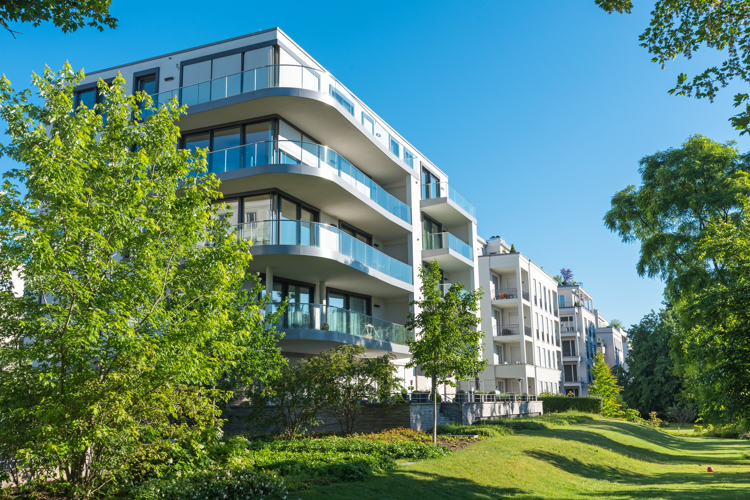
Zero-rated transactions and the sale of going concerns
A zero-rated VAT transaction, product, or supply does not mean that such a transaction is free or exempt from VAT.
VAT is rather levied at the rate of 0% and not 15%.
Therefore, if a transaction is zero-rated, it still falls within the ‘VAT net’ and all the provisions relating to VAT and legislation remain applicable.
Therefore, if a transaction in which the seller is a registered VAT vendor is not VAT-exempt, VAT may still be levied, but at the rate of 0%.

Slide 18
Zero-rated transactions and the sale of going concerns
Most important SARS requirements:
The seller and the purchaser must be registered VAT vendors at the time of conclusion of the sale.
The sale agreement must clearly state that the transaction constitutes the sale of a going concern at a VAT rate of 0% and includes the sale of the property and the income-earning enterprise together with its assets and existing contracts, business, staff, etc.
The entire business, including any part thereof which is capable of separate operation and any assets of the business, must be disposed of as part of the transaction.
The business must be an income-generating enterprise at the time of sale and remain such an income-earning enterprise until date of transfer.

Slide 19

Zero-rated transactions and the sale of going concerns: Risk considerations
Make sure that the sale agreement contains all relevant information (not in annexure or addendum).
Advisable to include both parties’ VAT registration numbers in the sale agreement, as well as a clause in terms of which both parties warrant that they are registered for VAT and their tax affairs are in order.
Include supporting documentation, where necessary and possible.
Example: Existing commercial lease agreements in the sale of a property and business as a rental enterprise.

Slide 20
Thank you

