Slide 1
Understanding exclusive use areas in sectional title schemes

Slide 2
DISCLAIMER
The training material provided is intended for training purposes only and should not be relied upon as a substitute for professional advice. The information presented is for general informational purposes and is not intended to be a substitute for legal, accounting, or other professional advice. We make every effort to ensure the accuracy and completeness of the information provided, but we do not guarantee that the information is error-free. We reserve the right to amend any errors in calculation or information presented in the training material. The information provided in the training material may not be suitable for all individuals or situations. You should always seek the advice of a professional before making any decisions based on the information provided. By using the training material, you agree to release us from any liability for any damages or losses, whether direct or indirect, that may result from your use of the information provided. We reserve the right to modify or discontinue the training material at any time without notice.

Slide 3

Introduction
A sectional title scheme has two components:
  Sections
  Common property
Sections can be owned.
Common property belongs to all owners of the sections in undivided shares.

Slide 4
Understanding exclusive use areas
You cannot assume that a particular building is a section or that a parking bay is an exclusive use area.
The only way to establish this is by checking the registered sectional title plan.
The registered plan is a blueprint for the Deeds Office to record the details of the sectional title scheme.
Exclusive use areas are parts of the common property that are ‘formally’ reserved for the use by the ‘owner’.
A garden, parking bay, patio, or another such attribute, may appear to be designed for the sole use of a section owner as an exclusive use area.
If it is recorded on the registered sectional title plan, it will reflect in the Deeds Office records and can be bought, sold, and mortgaged.

Slide 5
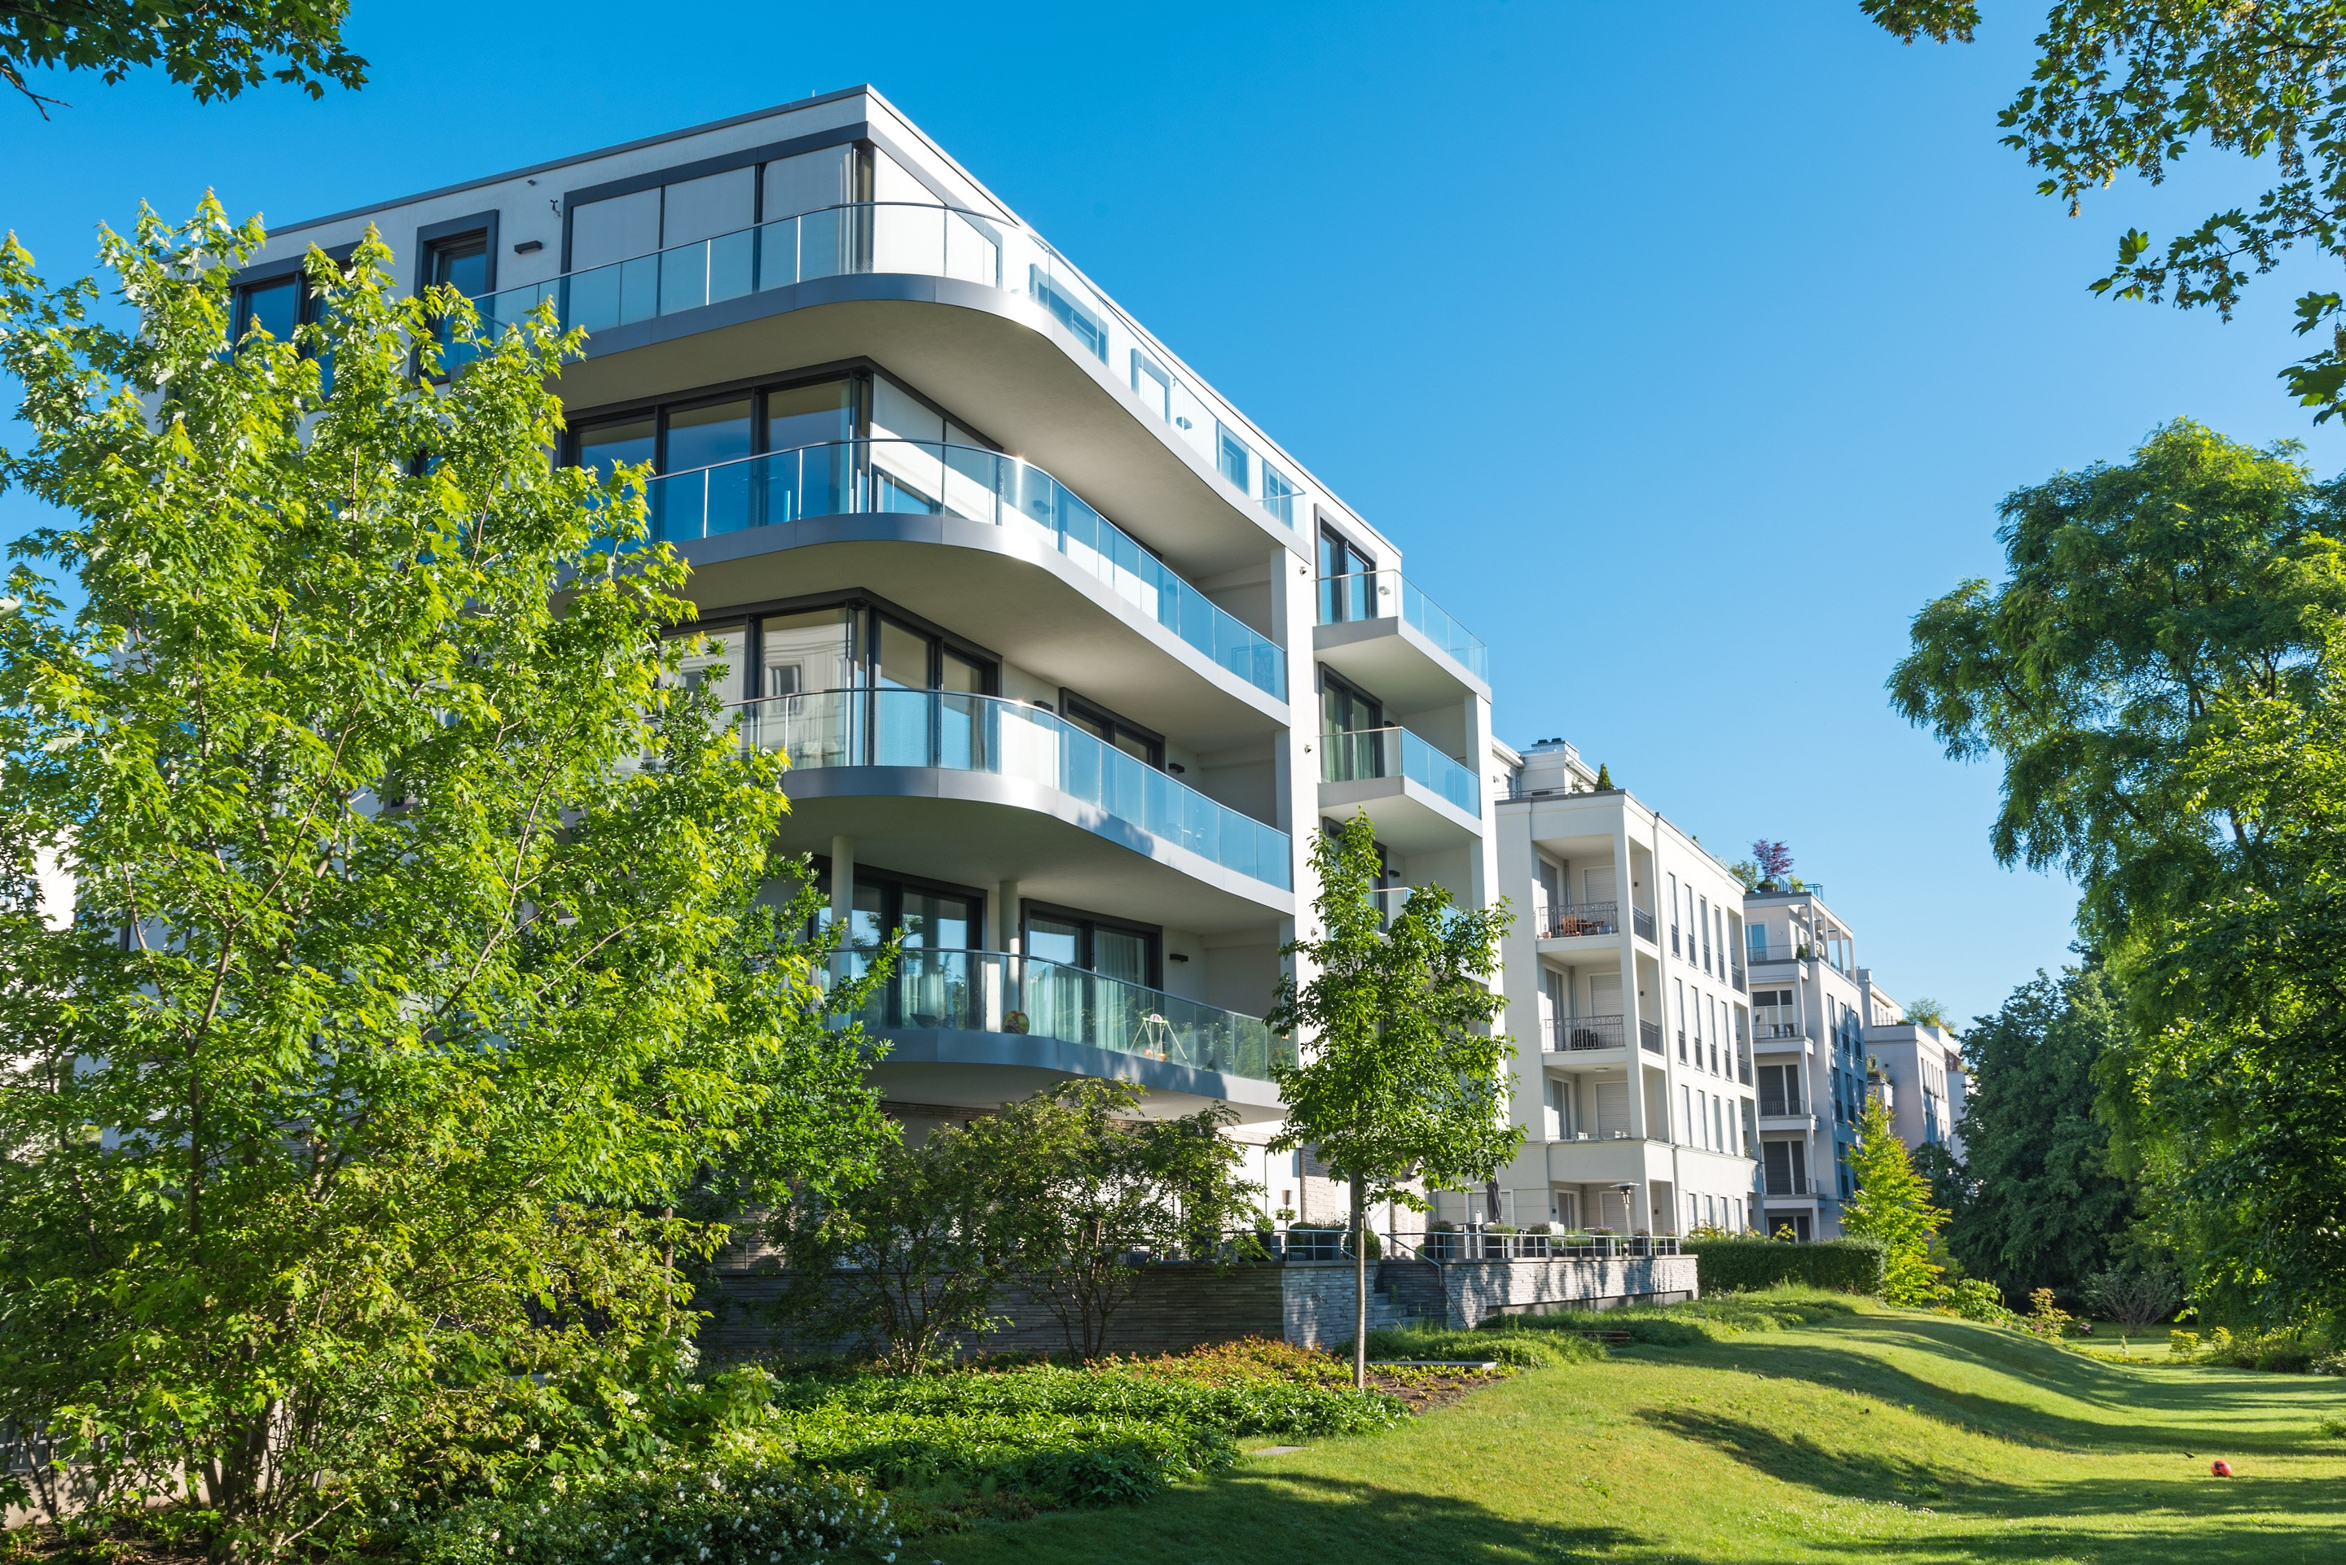
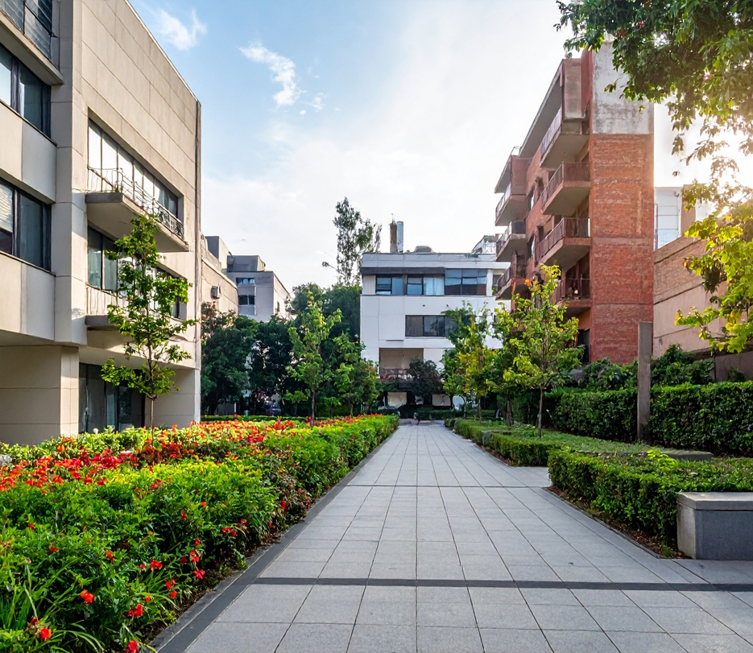
Formal v informal exclusive use areas
Developers may choose not to include EUAs on the sectional plan due to time and cost constraints associated with using land surveyors.
This means that areas like gardens or parking bays aren't formally recognised as EUAs by the Deeds Office.
Despite not being formally recorded, these areas may still exist and be used by the unit owner.
To address this, developers often allocate rights to certain areas in scheme rules.
These ‘informal’ EUAs are not legally designated but serve to differentiate them from formal ones.

Slide 6
Formal exclusive use areas
A ‘formal’ exclusive use area is a part of the common property reserved for the exclusive use of one or more section owners, as defined in the Sectional Titles Act.
These areas are clearly depicted on the registered sectional title plan, and include measurements and numbering.
Strict rules ensure accuracy in land records, which is crucial for property transactions and financing.
Transfer of rights to a formal EUA is termed a ‘cession’, not a transfer of ownership.
Formal EUAs can be mortgaged, and banks typically register bonds over both the section and exclusive use area.
Exclusive use rights are reserved solely for section owners.
Leasing of EUAs may be permitted under scheme rules, provided it is not expressly prohibited.

Slide 7
Informal exclusive use areas
EUAs allocated per scheme rules follow sections 10(7) and (8) of the Sectional Titles Schemes Management Act, with no Deeds Office registration or title deed.
These areas cannot be mortgaged but are secured through scheme rules’ strict amendment procedures.
Despite lacking formal documentation, rights to use these areas are equivalent to formally designated ones.

Slide 8
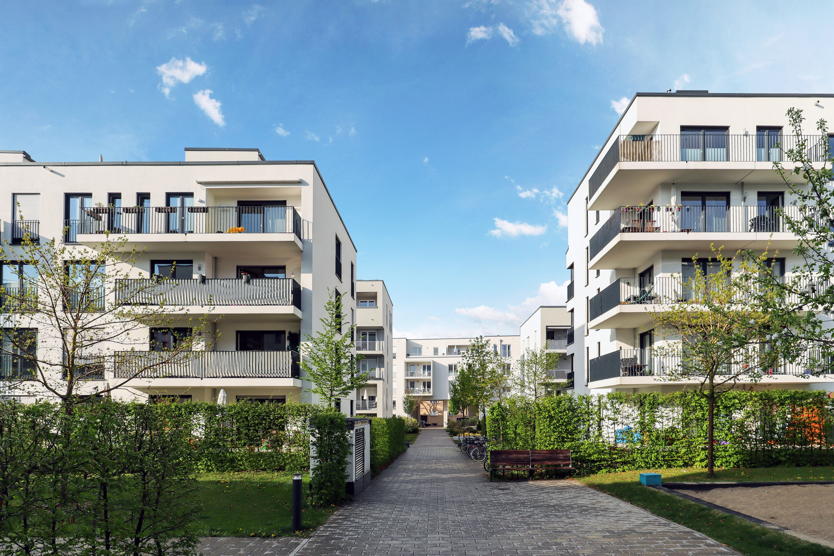
Potential confusion
Confusion arises as both holders exercise the same daily rights over these areas.
Many scheme owners are unaware of the legal-technical distinctions between these rights of use.
Even estate agents, trustees of the body corporate, and managing agents may lack adequate training to understand these differences.
Owners or users of both types of EUAs pay additional levies for their use.

Slide 9
Participation quota
An owner of a section in a scheme automatically owns an undivided share in the common property. HOWEVER, the shareholding is not equal.
In terms of the STA, an owner’s shareholding in the common property is determined by the size of their section in relation to other sections.
This is carefully calculated by the land surveyor, and shown on the sectional title plan, and is called the ‘participation quota’.
The participation quota impacts on the relevant owner’s levy liability and voting weight (amongst other things).
In practice, it does not translate into giving the owner more rights to use the common property than another owner.

Slide 10

Distinction between a section and EUA is not always clear-cut
It is possible for a building with four walls and a roof to be common property or an exclusive use area.
Therefore, don’t assume that something like a built garage or laundry is always a ‘section’.
It all depends on the sectional title plan.

Slide 11
Thank you

