Slide 1
Planning law essentials: Occupancy certificates, zoning, and restrictive title deed conditions

Slide 2
DISCLAIMER
The training material provided is intended for training purposes only and should not be relied upon as a substitute for professional advice. The information presented is for general informational purposes and is not intended to be a substitute for legal, accounting, or other professional advice. We make every effort to ensure the accuracy and completeness of the information provided, but we do not guarantee that the information is error-free. We reserve the right to amend any errors in calculation or information presented in the training material. The information provided in the training material may not be suitable for all individuals or situations. You should always seek the advice of a professional before making any decisions based on the information provided. By using the training material, you agree to release us from any liability for any damages or losses, whether direct or indirect, that may result from your use of the information provided. We reserve the right to modify or discontinue the training material at any time without notice.

Slide 3
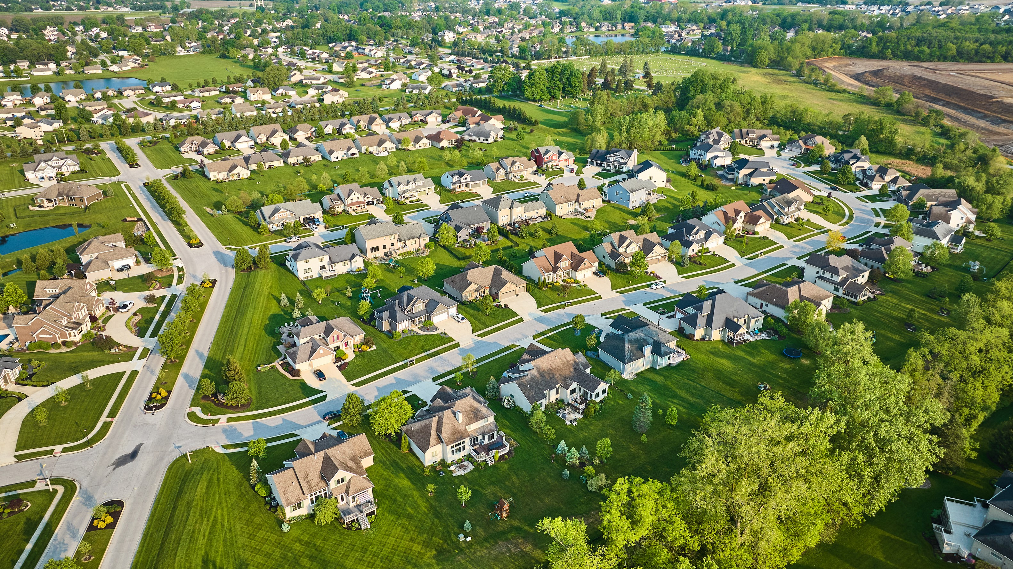
Zoning
Land is designated for a particular use and development.
The relevant zoning category sets out the purpose for which land may be used and the development parameters applicable, as per the relevant zoning scheme.
No person may utilise or develop land unless permitted in terms of the zoning scheme or approved under LUPA.
Rezoning, departures, and consent uses are made on application to the municipality, which considers various factors.

Slide 4
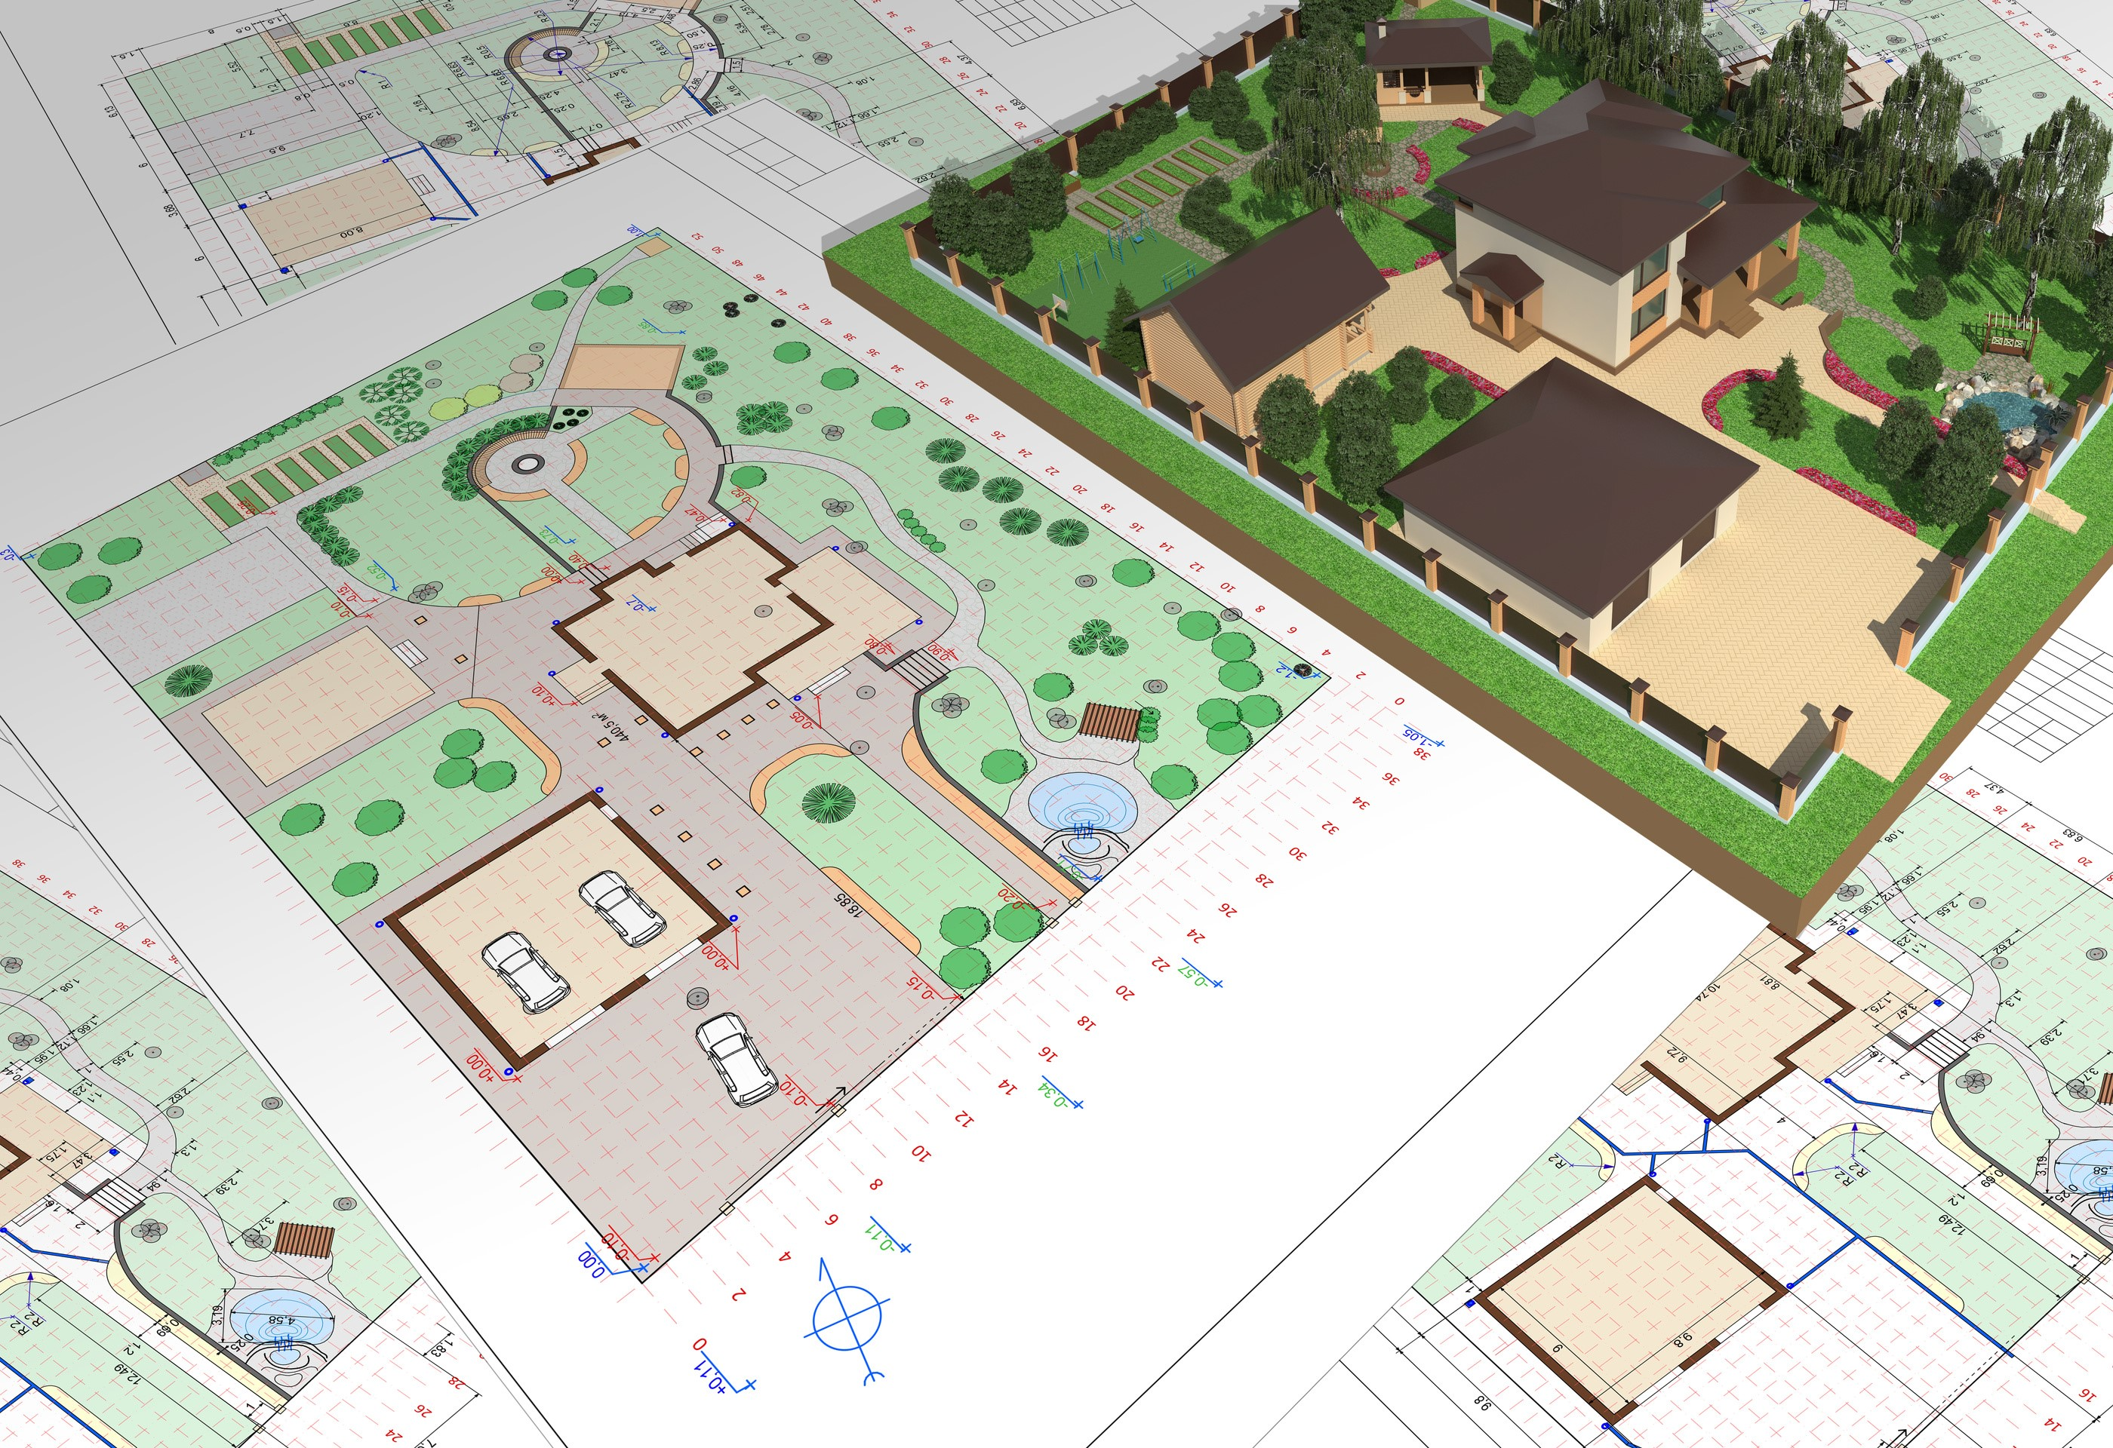
Zoning
The 3 broad categories for zoning are:
  Residential
  Commercial
  Industrial
SPLUMA gives municipalities authority over spatial planning within municipal areas.
SPLUMA acts as a ‘land use regulator’ assisting municipalities with exercising their authority in respect of land use developments, the regulation of population density, and housing policies.

Slide 5
Zoning: Weighing the pros and cons
Pros | Cons
Zoning may protect and enhance property values. | Zoning requires that all property owners to relinquish some of their individual property freedoms for the common good.
Zoning may help implement community goals. | Zoning may discourage development in some locations.
Zoning may conserve existing neighbourhoods and preserve existing structures. | Zoning may work against historic mixed-use neighbourhoods in older communities.
Zoning may preserve environmentally-sensitive areas. | Zoning sometimes limits the development potential of previously existing land uses and structures that do not conform with zoning standards.
Zoning gives the community some control over its land uses, appearance, and future quality of life. | Zoning may increase the cost of building new structures.
Zoning allows for potential nuisance uses to be located away from residential neighbourhoods or other sensitive areas. | Properly enforcing a zoning ordinance involves a long-term commitment to a certain level of community spending.

Slide 6
Zoning: Subdivisions and consolidations
No person may subdivide or consolidate land without the approval of the municipality.
Exception: The application is exempted in accordance with LUPA.
The Surveyor-General may not approve / amend a general plan or diagram in respect of a subdivision or consolidation without written confirmation from the municipality that the subdivision or consolidation is exempted.
The municipality must impose conditions relating to engineering services.
The municipality may impose a validity period for an approval.

Slide 7

Building plans
The National Building Regulations and Buildings Standards Act regulates building plans:
  Section 4(1) provides that a homeowner needs written prior approval from the local authority before starting any building work.
  Section 4(4) makes it a criminal offence to build without approved plans.
No plans? A building inspector can enter premises and stop construction, and the municipality or an aggrieved neighbour may apply for a demolition order.

Slide 8
Building plans
In South Africa, homeowners are entitled to design their own houses and submit their plans for municipal approval.
However, an architect must be appointed before the plans are submitted to the municipality for approval.
This ensures that the design complies with the minimum construction standards and specifications set out in the National Building Regulations and Building Standards Act.
Building plans indicate the size, height, and location of the building on an erf, as well as all relevant details.
To ensure that the plans are approved on time, it is important to regularly follow up with the municipality.
Sectional title schemes and complexes managed by homeowners’ associations will also have specific building rules, which may be obtained from the body corporate or HOA.

Slide 9

Occupancy certificates
An occupancy certificate is issued by the Building Control sub-directorate in terms of section 14 of the National Building Regulations and Building Standards Act.
The certificate certifies that a building (residential or commercial) has been completed according to its approved municipal building plans and other Council requirements.
It is compulsory for every building before occupation.

Slide 10
Occupancy certificates
The certificate specifies the type of building erected and is required before water and electricity deposits can be accepted for newly built properties.
The certificate is issued by the local authority indicating that:
  The building is in compliance with all regulations as determined when the drawing was approved; and that
  The building is in a suitable condition to be occupied.
All functional appliances like sanitary ware, light fittings, and stove must have been tested and be working properly.
A key reason for the certificate is safety.
It is imperative that the building is compliant with the approved plans and meets all applicable SANS, rules, and regulations.

Slide 11
Restrictive title deed conditions
The most common title deed conditions are restrictive conditions.
Conditions registered in title deeds during the process of township establishment by the township developer in terms of which restrictions are placed on land use.
The purpose of restrictive conditions is to ensure a harmonious layout of the township and to preserve its character.
This can be frustrating, but rest assured that restrictive conditions may be amended or removed.
LUPA governs the amendment or removal of restrictive conditions in the Western Cape.
Section 1 of LUPA defines a restrictive condition as ‘any condition registered against the title deed of land restricting the utilisation, development, or subdivision of the land concerned, excluding servitudes creating real or personal rights.’
LUPA is given real force through the City of Cape Town Municipal Planning By-Law, 2015 (as amended).

Slide 12

Tips for success
Familiarise yourself with the basics of planning law: Know how zoning works, keep up to date with current matters, read SPLUMA, LUPA, and the National Building Regulations and Buildings Standards Act, and understand how municipalities implement this legislation.
Importantly, always check the title deed of the property for restrictive (and other) conditions which may influence potential zoning and building plans.
Always know that we are just an email away should you require any assistance!

Slide 13
Thank you

