Slide 1


Slide 2
Logbook Training
Module 1 : Introduction

Slide 3
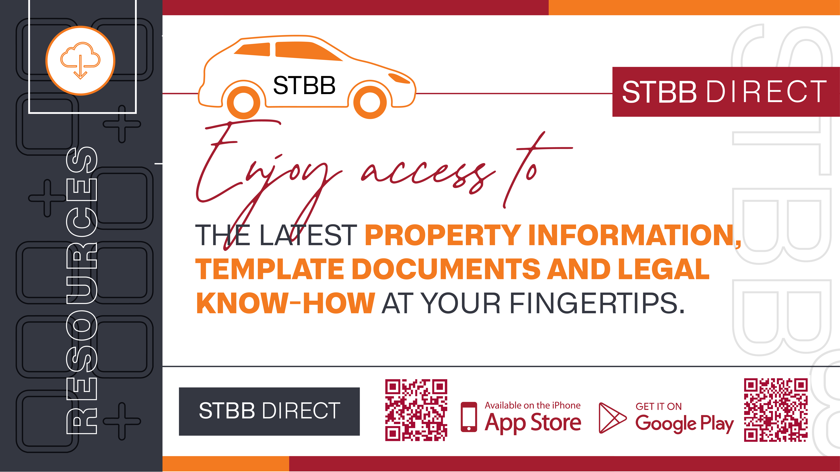

Slide 4
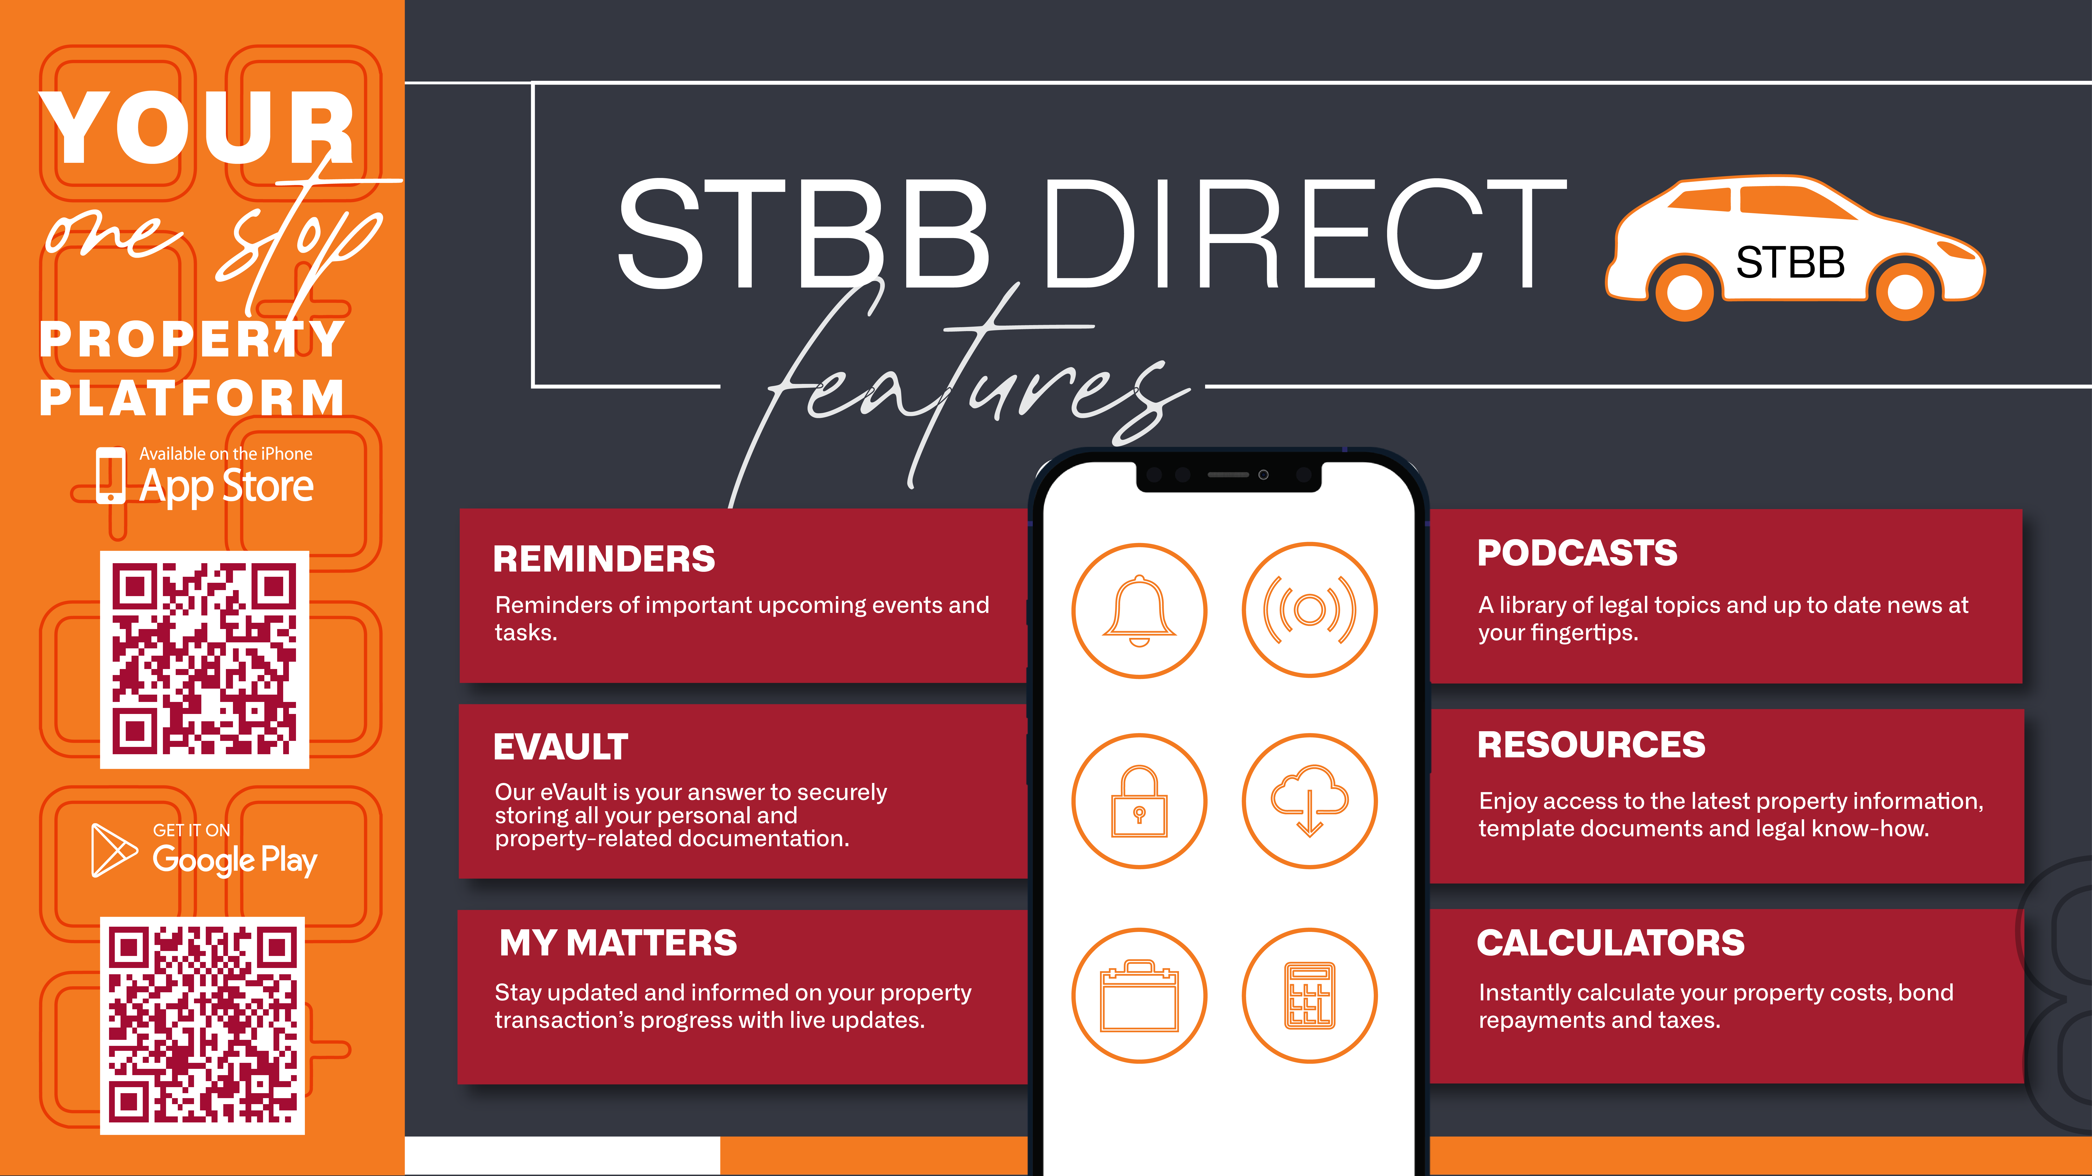

Slide 6
Planning the Journey
Date | Modules
 | Intern programme
 | Induction Performance Appraisals
 | Code of Conduct Product Training
 | Legal Environment Compliance with Estate Agency Affairs Act/Property Practitioners & FICA
 | Financial Environment
 | Marketing/Selling leasing of a property Management environment
 | Administration environment
 | Paralegal environment
 | Human Resources Management
 | Marketing Generally & Other workplace activities & signoff

Slide 8


Slide 10
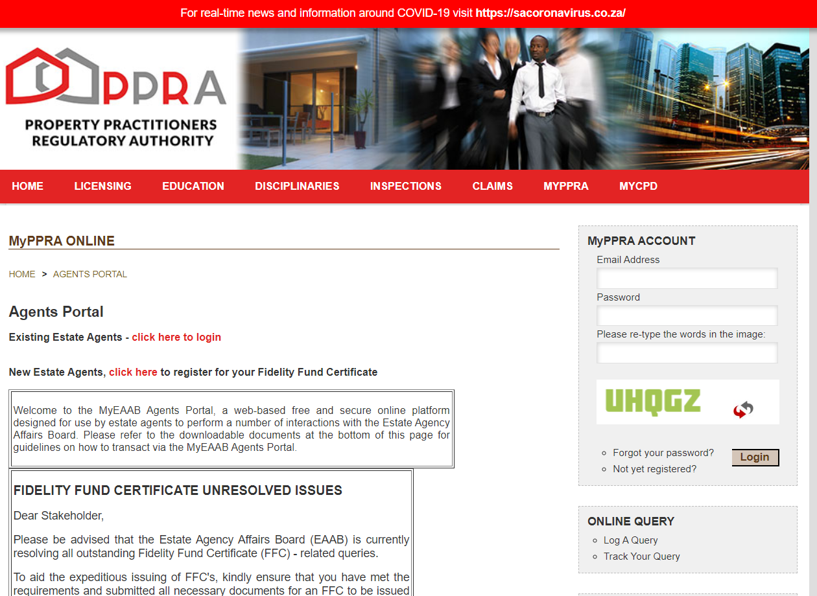

Slide 11
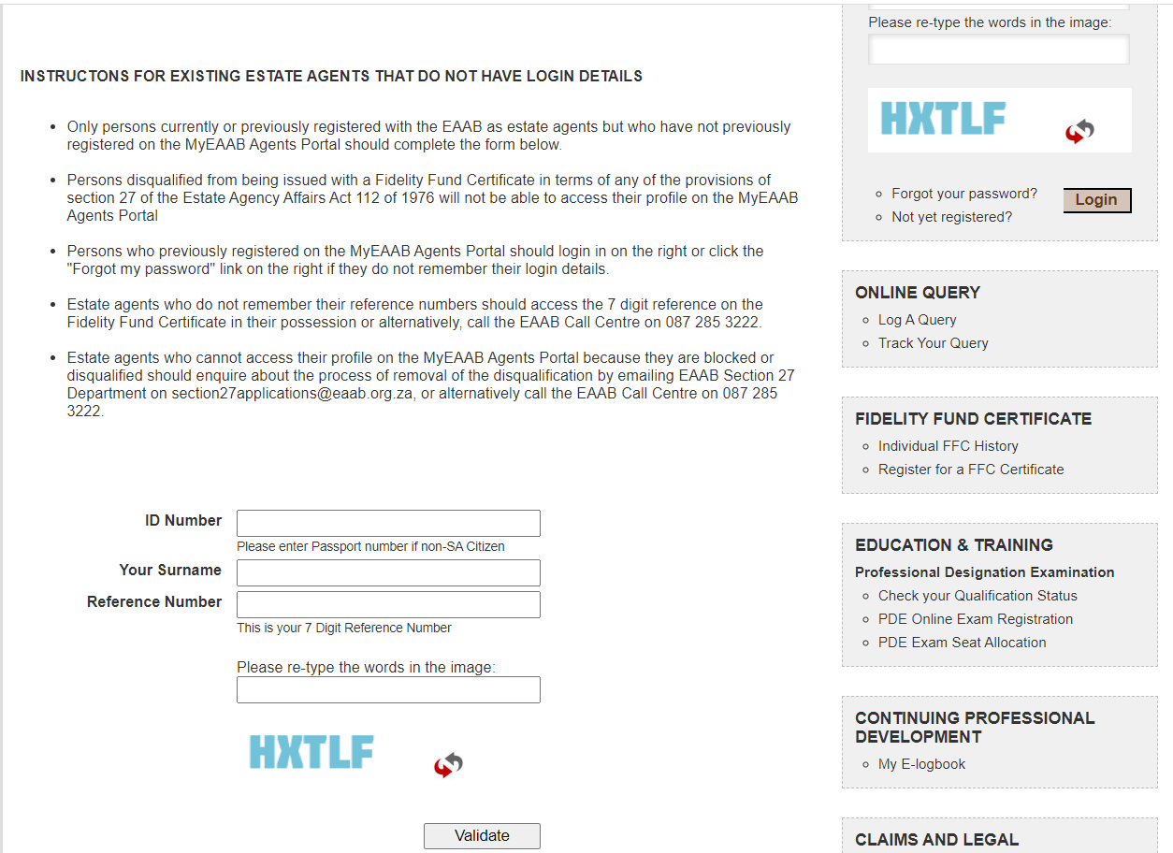

Slide 12
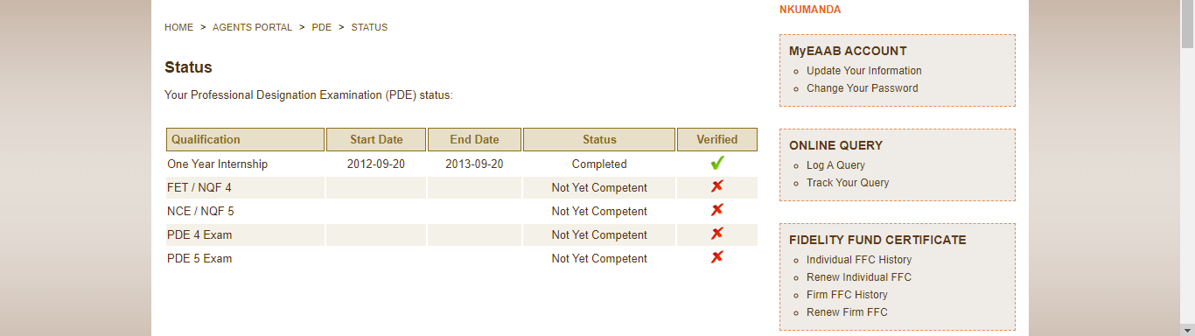

Slide 13
Completing your Logbook
Practical Projects
Ten projects in the EAAB logbook were specifically designed to accommodate the core roles and responsibilities of the professional non-principal estate agent - optional
The intern estate agent should remember to always insert the naturally occurring evidence obtained when completing the projects into their logbook.

Slide 14
Duties and Responsibilities
Intern Agent
An intern estate agent is required diligently to:
complete all information required in the prescribed logbook;
complete training on all areas within real estate facets during the course of the twelve month internship period and also file applicable evidence of having done so in the logbook;
complete workplace task forms and also file any applicable evidence in connection with the tasks in the logbook;
regularly meet with the principal to plan the practical workplace experience program and, at least monthly, to obtain an appraisal report on progress being made; and
ensure that the principal timeously signs off the logbook as certification that the intern estate agent has been exposed to the required workplace experience.

Slide 15
Duties and Responsibilities
Principal / Mentor / Coach / Supervisor
The principal is required to:
familiarise himself/herself with all logbook requirements;
regularly meet with the intern estate agent to plan workplace activities;
ensure that the intern estate agent is provided with the opportunity to be exposed to each new learning situation;
sign off, in the intern estate agent’s logbook, all activities that have been completed by the intern estate agent; and
complete at least a monthly appraisal report on the progress made by the intern estate agent and ensure that the appraisal report is inserted into the intern estate agent’s logbook.

Slide 16
Internship Agreement
When you join an agency as an intern, you will be required to sign an internship agreement as well as fill in any other necessary forms required.
A recommended internship agreement has been made available by the PPRA and we have placed a copy in your file.

Slide 17


Slide 18
Activities
To do before the next session
Complete Internship Agreement (pages 4 – 6)
Complete Details on Intern Agent (page 8)
Complete Details of Principal Agent (page 9)
Insert a copy of your Identity Document certified
Insert a blank letterhead of your Estate Agency
Complete Educational Background and Work experience
Provide proof of educational background
Complete CV

Slide 19
Preparation
Have ready for the next session
Letter of employment & contract
Induction notes
Policy and procedures of your agency
Screenshot of agency website, systems

Slide 20


Slide 21


Slide 22


