Slide 1
Logbook Training
Module 9 : Human Resource Environment

Slide 2
HUMAN RESOURCE MANAGEMENT
“Human Resource Management is concerned with the people dimension” in management. Since every organization is made up of people, acquiring their services, developing their skills, motivating them to higher levels of performance and ensuring that they continue to maintain their commitment to the organization it is essential to achieve organisational objectives. This is true, regardless of the type of organization – government, business, education, health or social action”.

Slide 3
Human Resource Management
TYPICAL RESPONSIBILITIES
Managing job recruitment, selection, and promotion
Developing and overseeing employee benefits and wellness programs
Developing, promoting, and enforcing personnel policies
Promoting employee career development and job training
Providing orientation programs for new hires
Providing guidance regarding disciplinary actions
Dispute resolutions
Serving as a primary contact for work-site injuries or accidents
Creating organizational alignment
Performance management

Slide 4
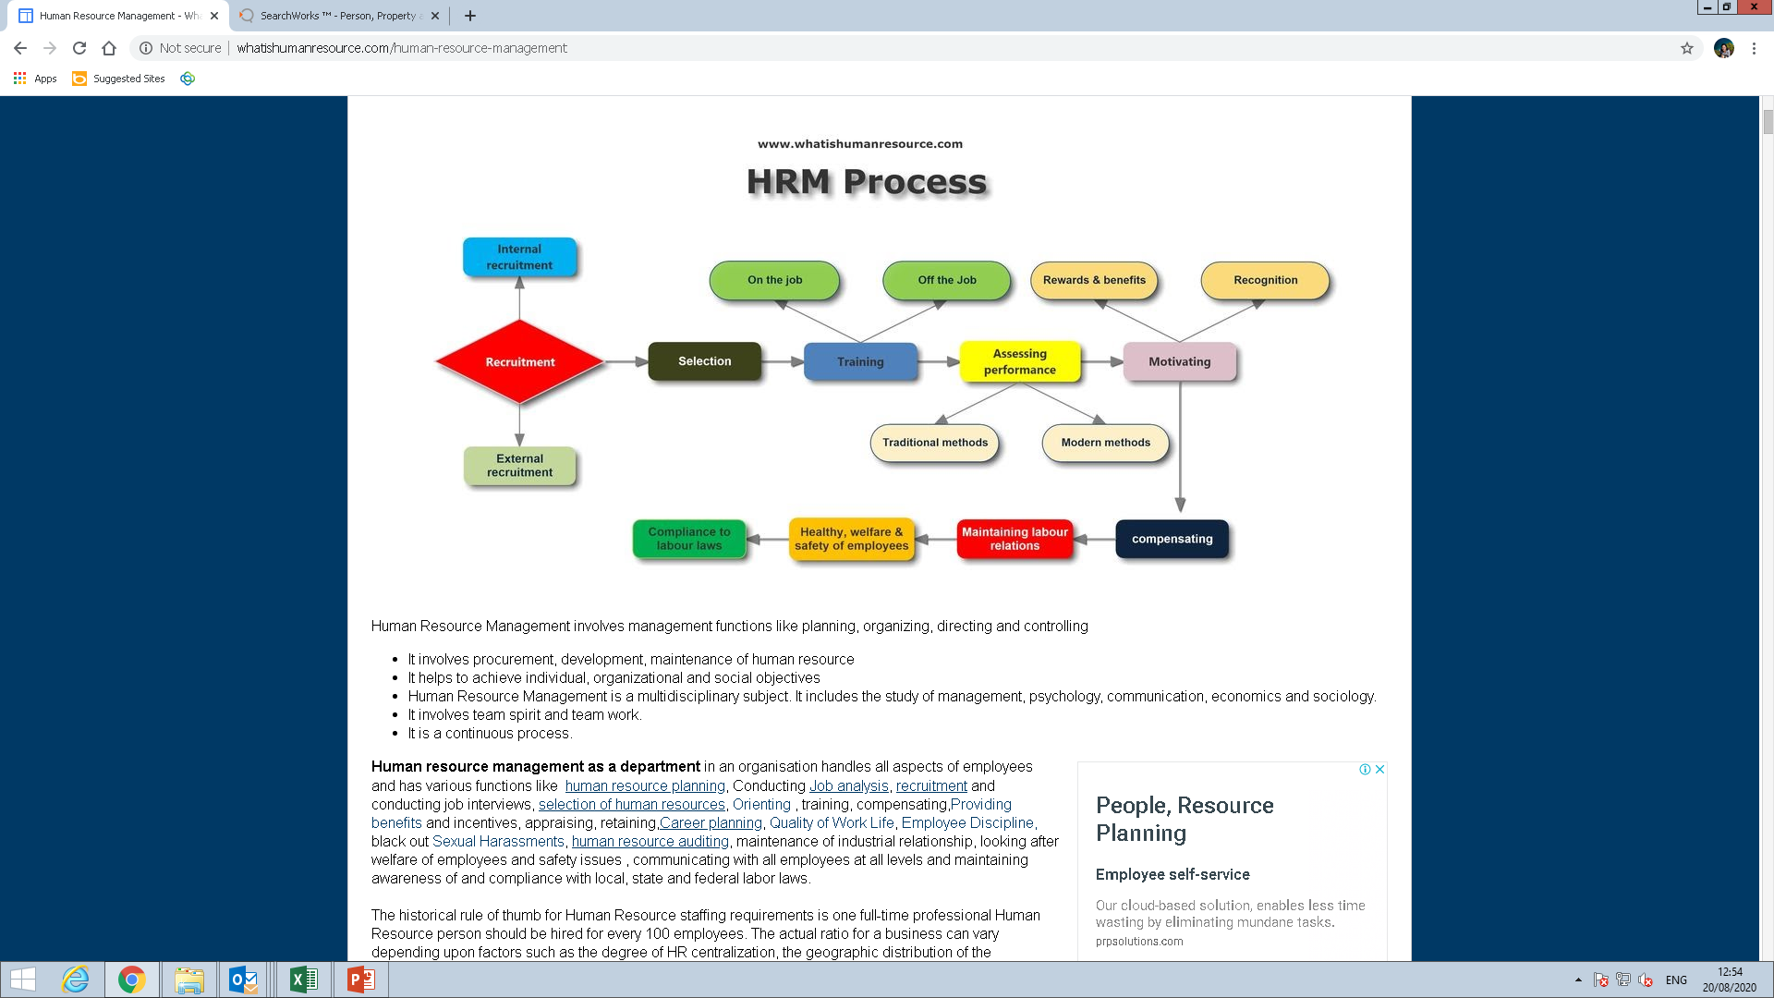
Human Resource Management
THE PROCESS

Slide 5
Human Resource Management
While respecting the confidentiality of certain information, the intern estate agent should be aware of the following:
Current personnel information;
The methods implemented within the agency to ensure all records are maintained;
Capturing overtime payments, commissions due and other ad-hoc staff expenditure
Checking, capturing and maintaining necessary timesheets
Capturing mandatory information on new appointees, terminations of service, transfers & promotions on payroll
Leave policy and leave records
Compensation for occupational injuries and diseases
Disciplinary procedures
Grievance procedures
Training registers
Payslips and tax
Incentive schemes and award ceremonies
IN GENERAL

Slide 6
Human Resource Management
DISCIPLINARY PROCEDURE
Verbal warning
Written warning
Final written warning
Suspension
Demotions

Slide 7
GRIEVANCE
Dale Yoder defines it as “a written complaint filed by an employee and claiming unfair treatment.
Prof. Pigors and Meyers define grievance as dissatisfaction. According to them, dissatisfaction of an employee is anything that disturbs the employee, whether expressed or not.

Slide 8
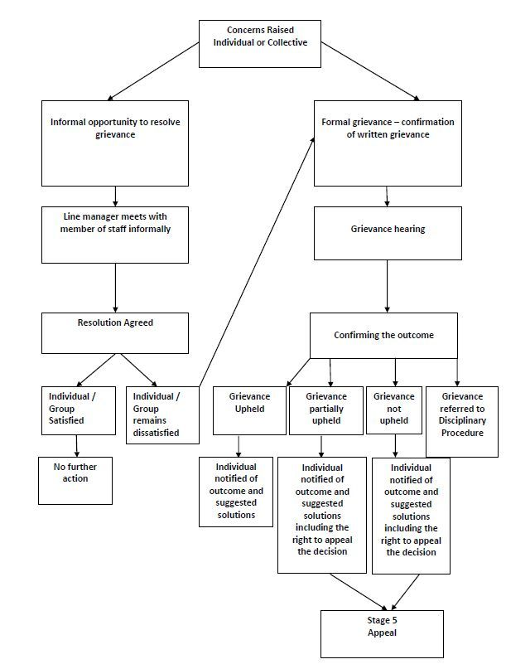
Grievance
THE PROCESS

Slide 9
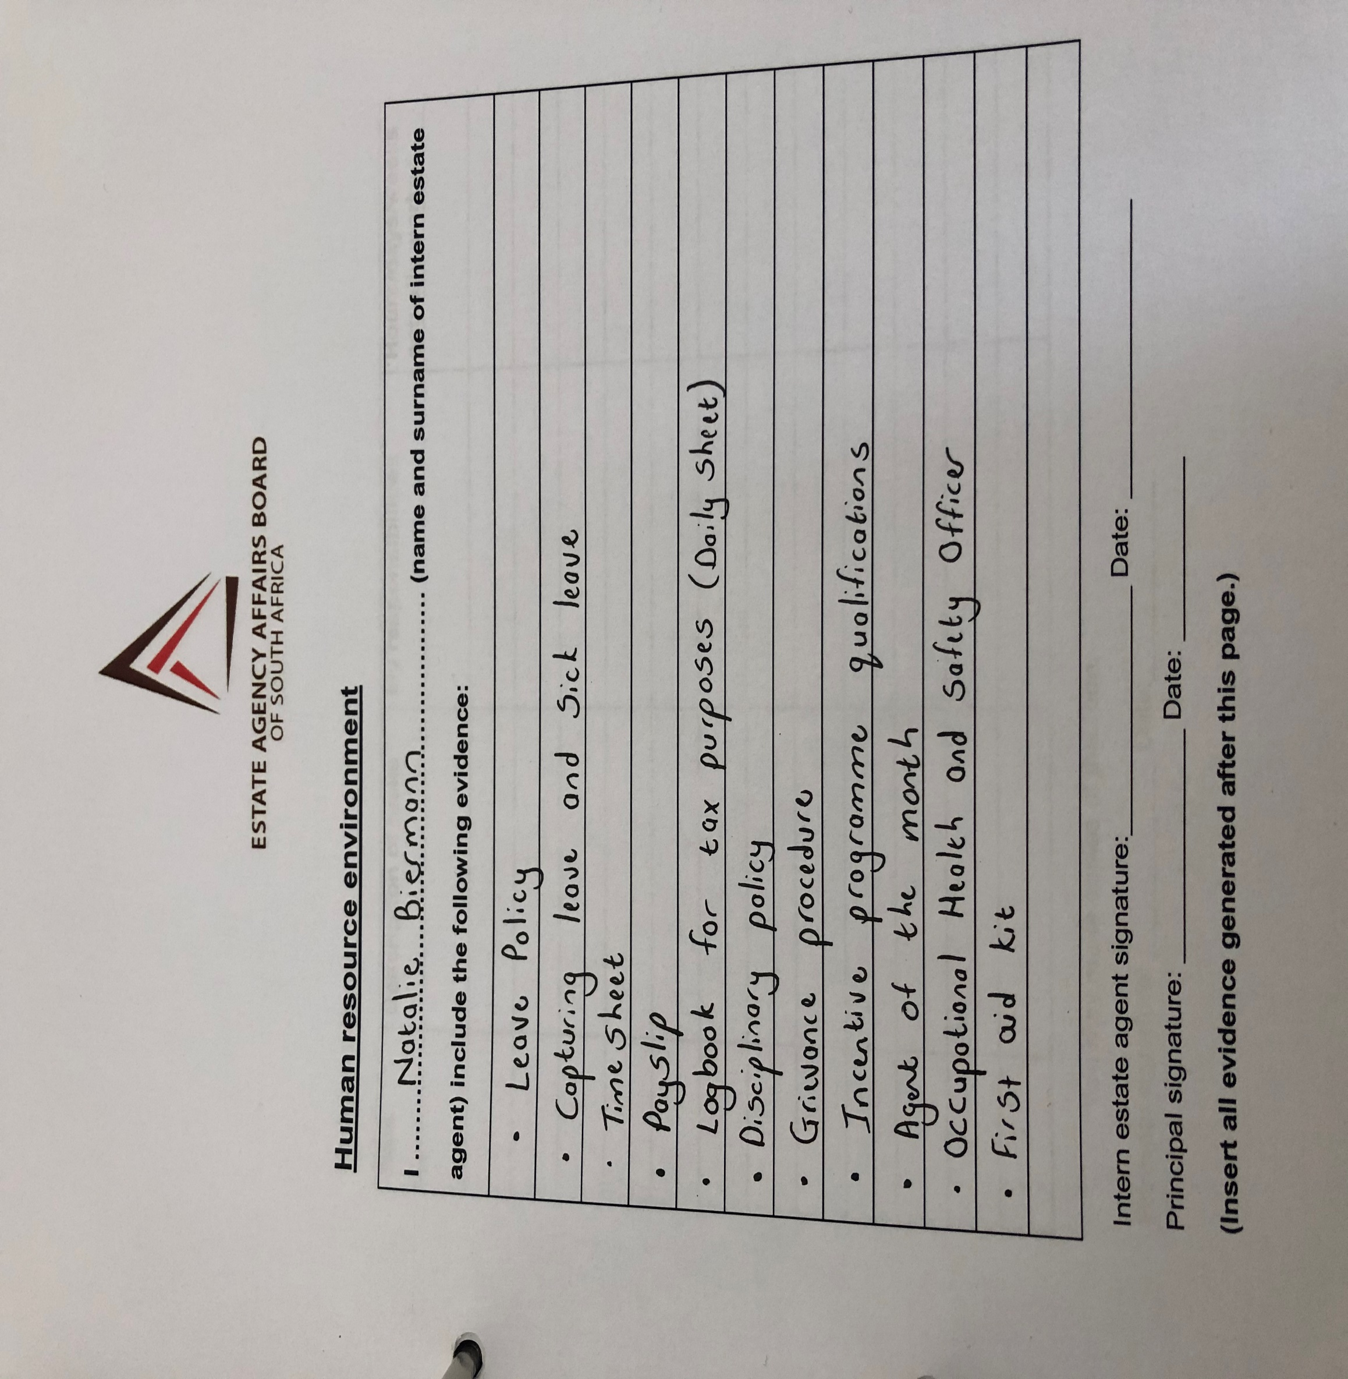

Slide 10
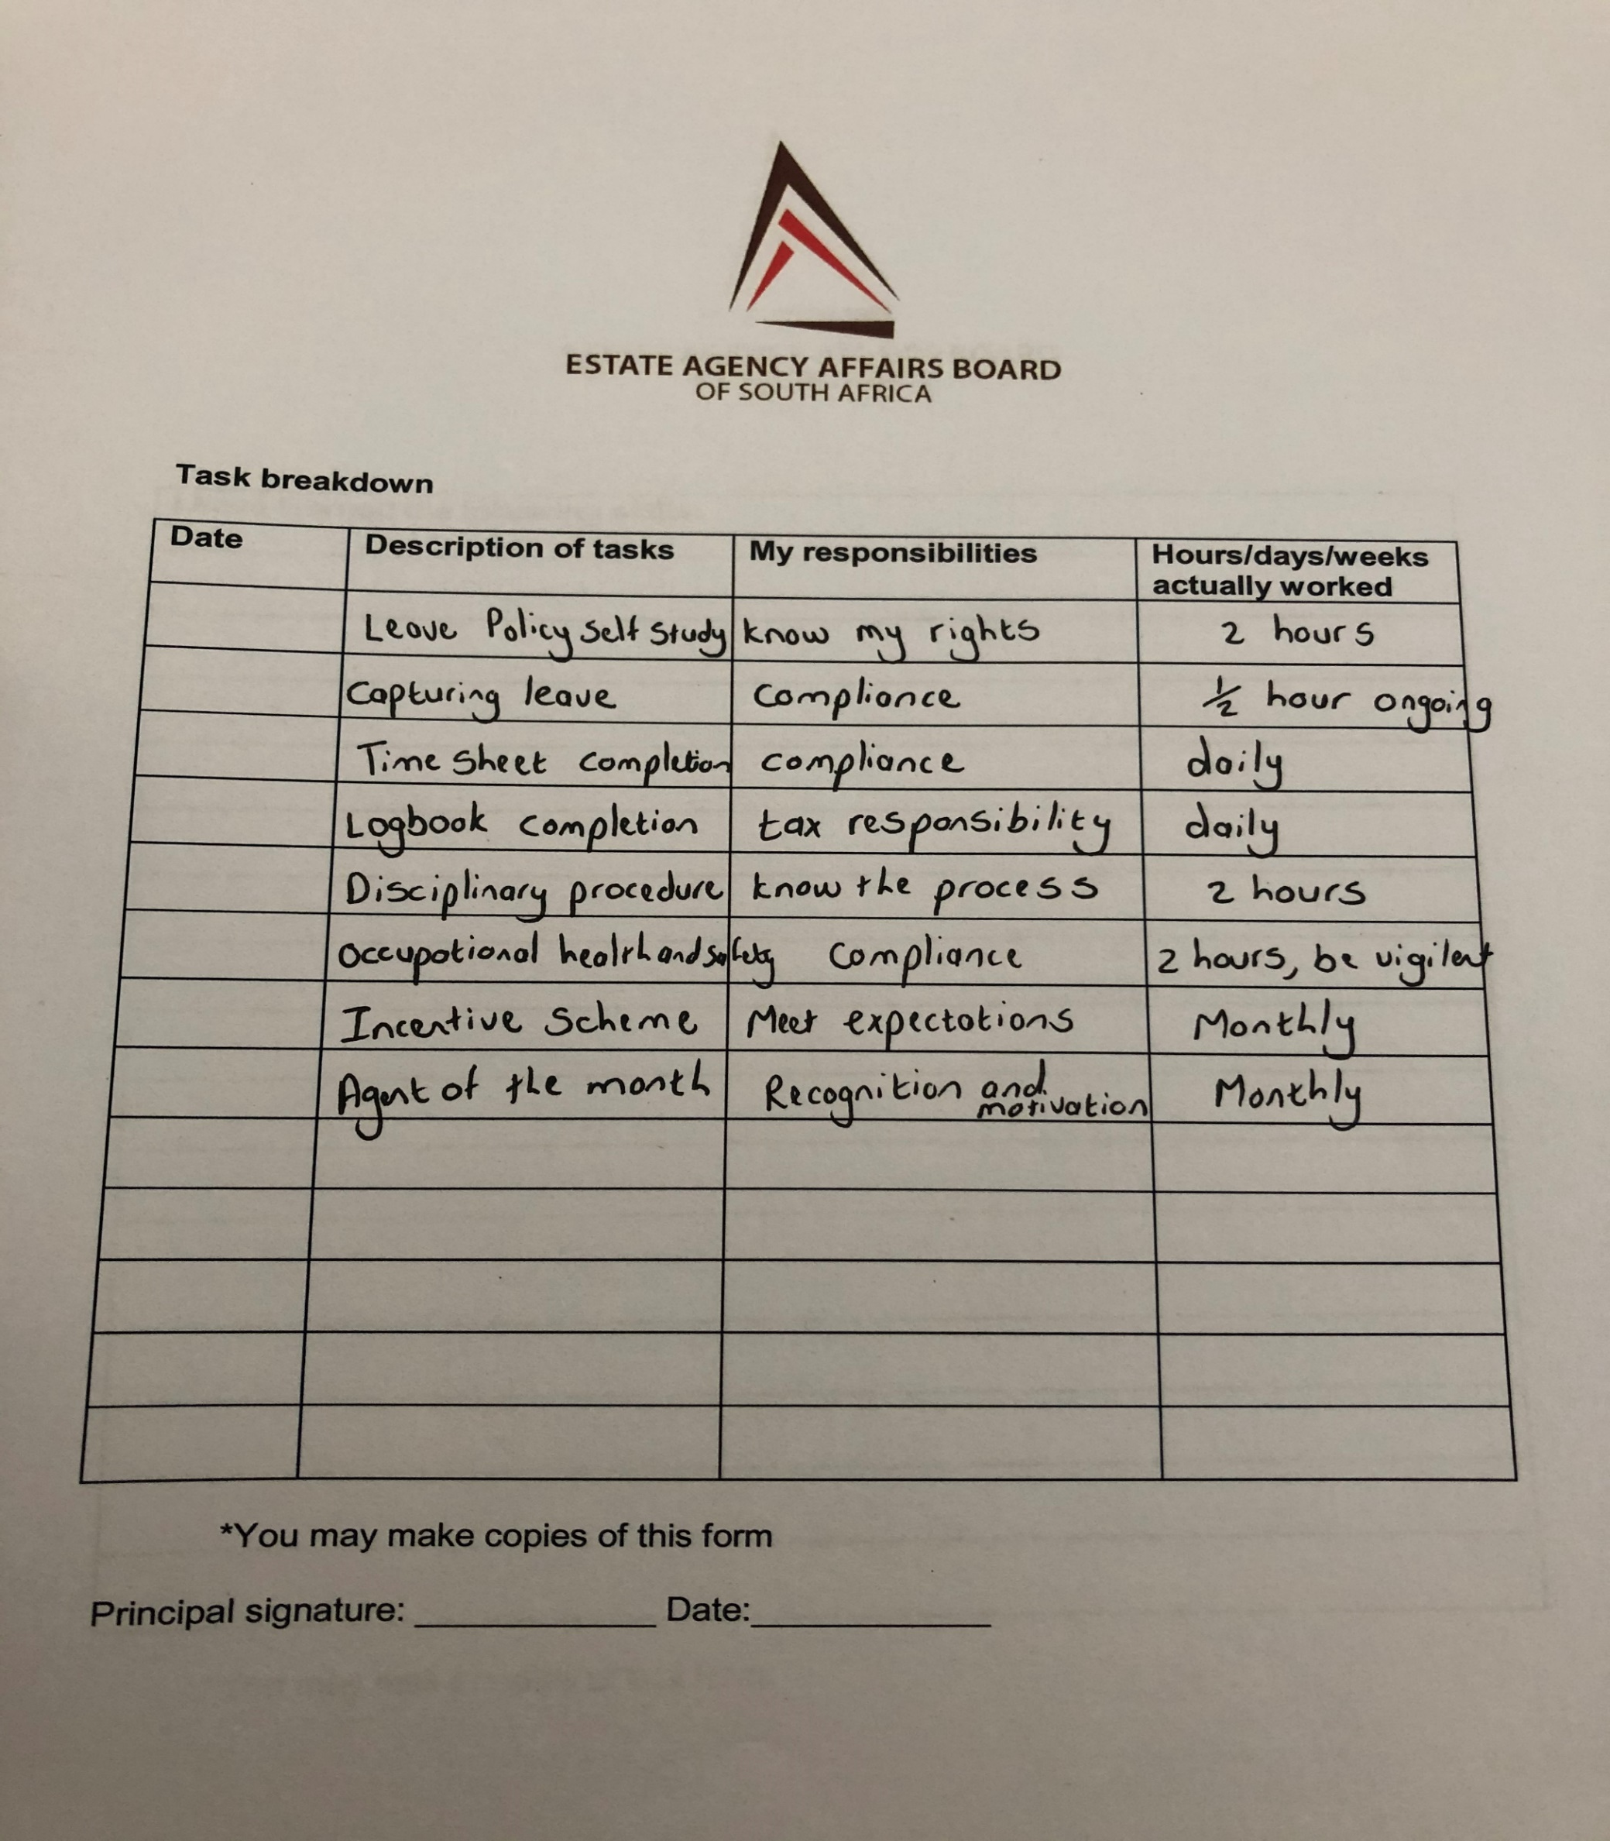

Slide 11
QUOTE OF THE DAY
"You must treat your employees with respect and dignity because in the most automated factory in the world, you need the power of human mind. That is what brings in innovation. If you want high quality minds to work for you, then you must protect the respect and dignity. " - Mr N.R. Narayana Murthy, Chairman Emeritus, Infosys Ltd.

Slide 12
PERFORMANCE APPRAISALS

Slide 13
Performance Appraisals
EXAMPLE

Slide 14


Slide 15
Activities
To do before the next session
Complete pages 91 – 93
Provide evidence accordingly
Obtain a performance appraisal and file

Slide 16
Preparation
Have ready for the next session
Flyers of any additional marketing
Happy Mother’s day / Spring day / Valentines day
Gold day photos or additional team building
Any material you use to market yourself
Charity events

Slide 17


Slide 18


Slide 19


