Slide 1
Logbook Training
Module 10 : Marketing Generally

Slide 2

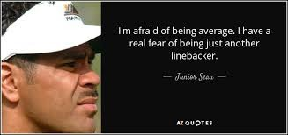
Marketing
How do you market yourself?
How do you stand out from your competition?
What do you do differently?
Which ideas or initiatives are you coming up with?
Are you going to be creative, do great things and stand out from your competition?
These are crucial questions to ponder on and decide whether you are going to settle for being an average agent or be an AMAZINGLY SUCCESSFUL agent!!!

Slide 3
Marketing
BRAND BENEFITS
Customer recognition
Customer loyalty
Credibility
Gives confidence
Brand equity
Attracts talent

Slide 4









Marketing
EVIDENCE
Branding your car
Personalised calendars
Delivering a personalised gift to clients
Social media campaigns
Personalised mailers for special days
Doing personalised videos & blog posts
Doing a sponsorship at a school
Your For Sale boards or advertising boards
Digital and/or business cards

Slide 6
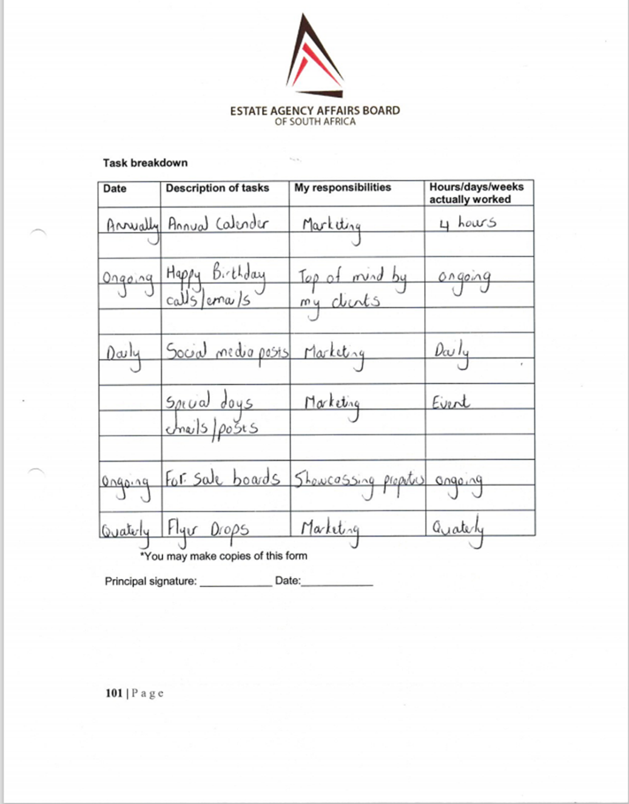

Slide 7
OTHER WORKPLACE ACTIVITIES

Slide 8
Other Workplace Activities
PAGE 103
Sponsorship of golf days
Sponsoring cycling shirts for a group cycling the Cape Town Cycle Tour
Playing bowling events at your local bowling club
Sponsoring big sports day at a local school
Charity drives
Blanket drive in winter
Animal welfare support
Large billboard of your agency along a main road or highway
Digital magazines of agency
Social media campaign

Slide 9
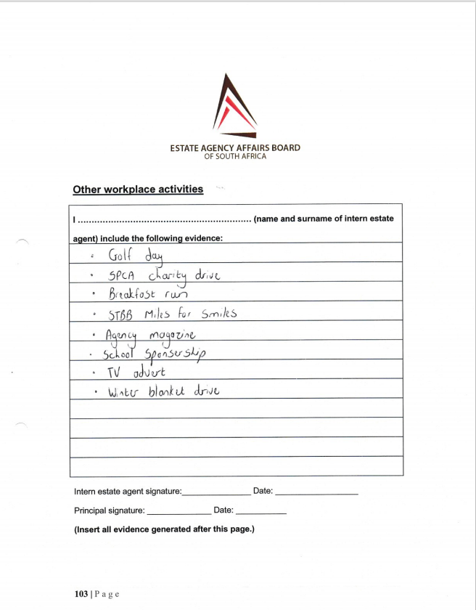

Slide 10
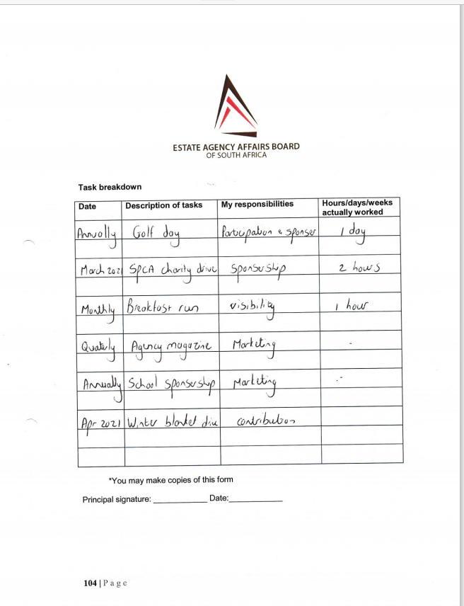

Slide 11
PERFORMANCE APPRAISALS

Slide 13
SIGN-OFF

Slide 14
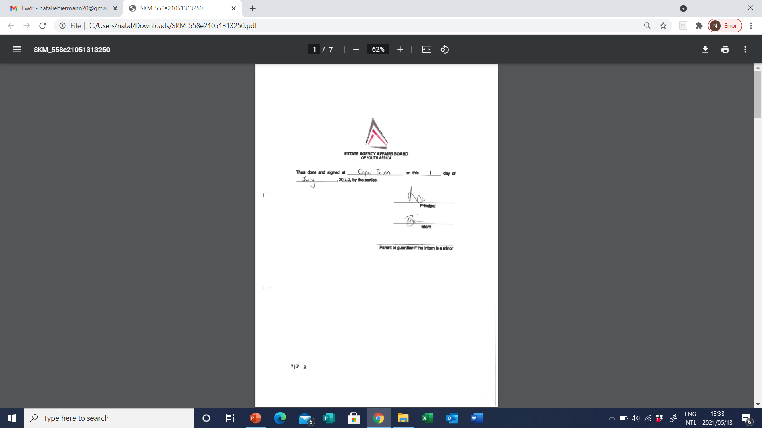

Slide 15
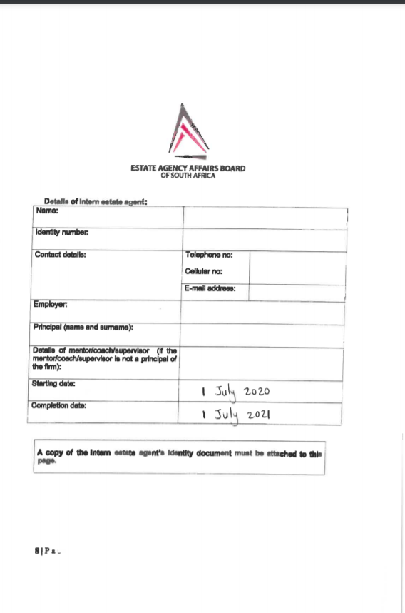

Slide 16


Slide 18


Slide 19
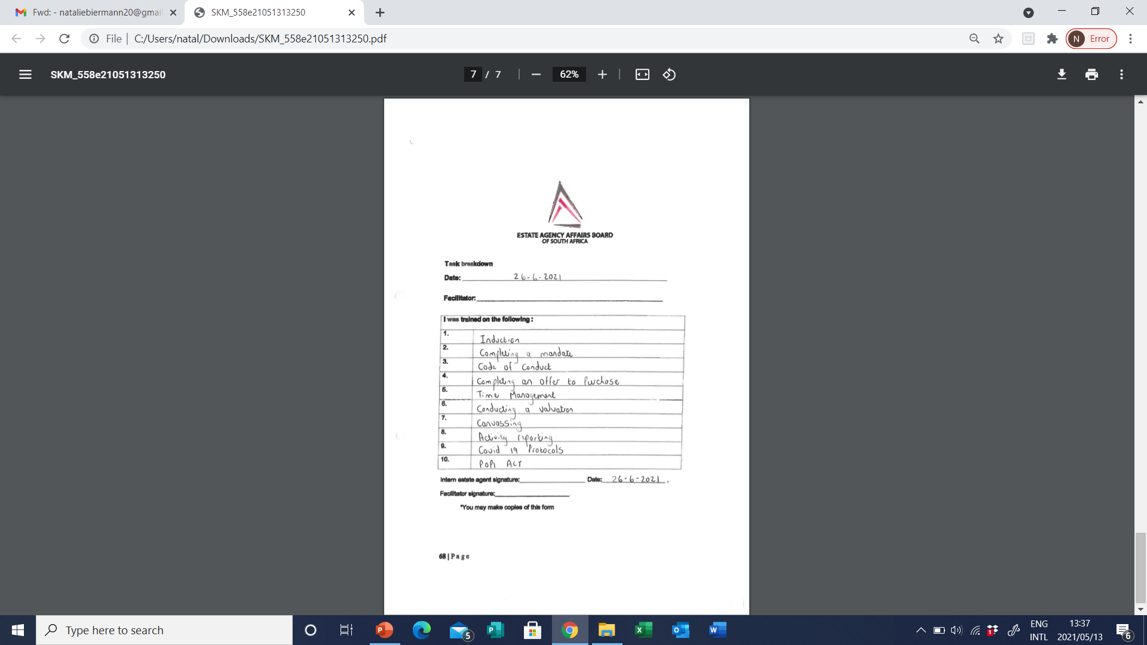

Slide 20
Sign-off
Check each module – signed by yourself and your mentor. Your dates are a running timeline of your mentorship year.
Check your evidence and that sufficient evidence placed in your file.
Make an electronic copy or hard copy of your file to keep.
Hand in or courier to Property Practitioners Regulatory Authority
Cape Town: Constitution House, 126 Adderley Street, 6 th floor
Gauteng: 63 Wierda Road, Wieda Valley, Sandton
Obtain proof that you have handed in and keep the proof.
Email will be received from EAAB. Estimated time frame for review 60 days.
Logbook approved & NQF 4 uploaded you can register for PDE

Slide 21


Slide 22
Activities
Complete Marketing generally (pages 100 – 102)
Provide evidence accordingly
Complete Other workplace activities (pages 103 – 105)
Provide evidence accordingly
Obtain performance appraisal
Complete sign-off
Make electronic copy and hand in file.
Check that status updated for logbook.

Slide 23


Slide 24


Slide 25


